Slide 1



MOBILE PRIVACY

Slide 2

WRITE THIS STUFF DOWN
@flexlibris
@libraryfreedom
alison@libraryfreedomproject.org
libraryfreedomproject.org/resources/mobileprivacytoolkit

Slide 3

PHONES ARE BAD

Slide 4

Baseband/data network
Location services
Wifi
Bluetooth
App access to device
Proprietary software
Cameras and microphone
Government, police, corporate surveillance
Android vs iOS
Android Nexus vs all other Androids

Slide 5

THE MOST IMPORTANT THING

Slide 6
Settings
IOS
Settings → Touch ID & Passcode
Settings → Spotlight Search (off)
Settings → Keyboard → Predictive Text (off)
Settings → Keyboard → Enable Dictation (off)
Settings → Privacy → Location Services
Only give access where necessary
Settings → Privacy → application data requests (review) Settings → Privacy → Diagnostics & Usage (don't send)
Settings → Privacy → Advertising → Limit Ad Tracking

Slide 7
Settings
Android
Settings → Connections → turn off all Settings → location (off)
Settings→ more → Security
Password
Encrypt device
Device administrators
Unknown sources (uncheck)
Verify apps (check)

Slide 8
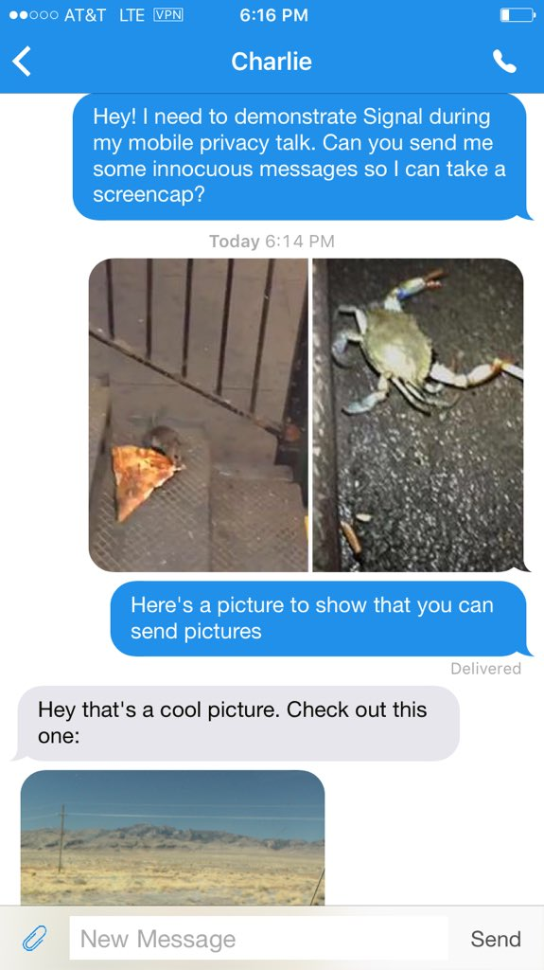
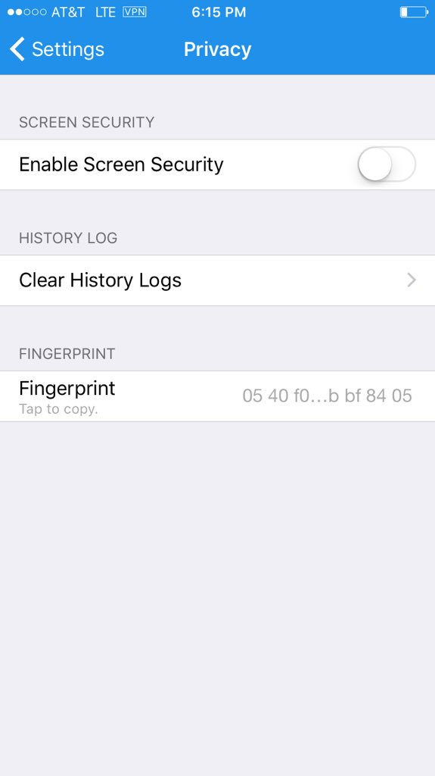
Signal (for iOS or Android):
safer calls and texts

Slide 9
Mobile Browsers
Default browser for Android (don't use it)
Safari for iOS
Chrome or Firefox for Android or iOS
Tor Browser for mobile:
-Orweb for Android
-Onion Browser for iOS

Slide 10


What is Tor?
How is it different for mobile?
Onion browser for iOS (not official)
Orbot: proxy with Tor for Android
Orweb: Tor Browser for Android

Slide 11

Invisible trackers

Slide 12

Safer searching
Android: Firefox/Chrome→ settings→ customize search→ DuckDuckGo
iOS:
Settings→ choose browser→ search engine→ DuckDuckGo

Slide 13

Virtual private networks

Slide 14

More...stuff
Compartmentalization
Cover cameras
Exif and exif removal
(ObscuraCam for Android)
High security situations
IMSI Catchers/Stingrays and Snoopsnitch
Faraday cages

Slide 15




Extra credit
Hardening Android
The Guardian Project (Android)
Fdroid: FOSS app store for Android
Privacy Grade: more info on app permissions
ownCloud mobile (iCloud alternative)
Cyanogenmod (Android OS)
Replicant (Android OS)

Slide 16


Slide 17


alison@libraryfreedomproject.org
@libraryfreedom
libraryfreedomproject.org/feedback
CC-BY-SA 4.0 International
www.creativecommons.org

